Slide 1
2
Hardware and Software

Slide 2
Outline and Learning Objectives
Introduction to Hardware (HW).
Introduction to Software (SW).
Differentiate between the two SW types.
Discuss strategic issues that link HW & SW design to business strategy.
Explain how HW & SW can be integrated into the business processes and strategies.

Slide 3
Hardware: Physical Equipment
Physical equipment used for……of a CBIS:
  Input
  Processing
  Output
  Storage activities
HW Decisions:
  Task
  Speed
  Cost

Slide 4
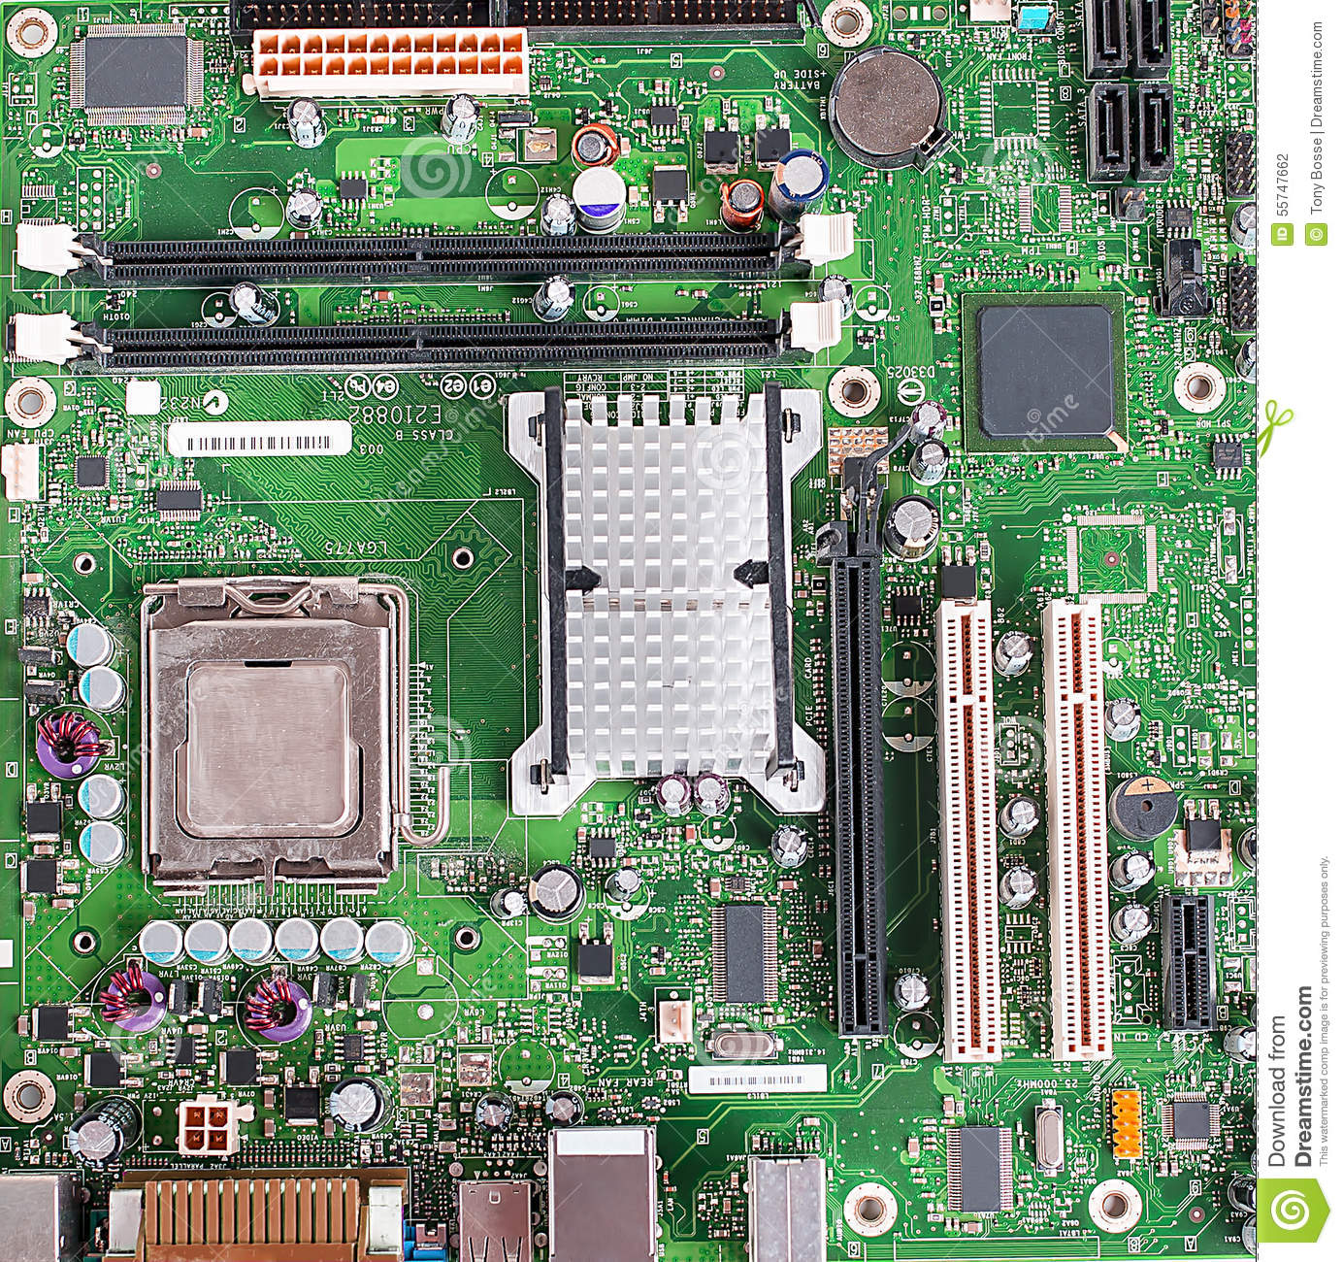
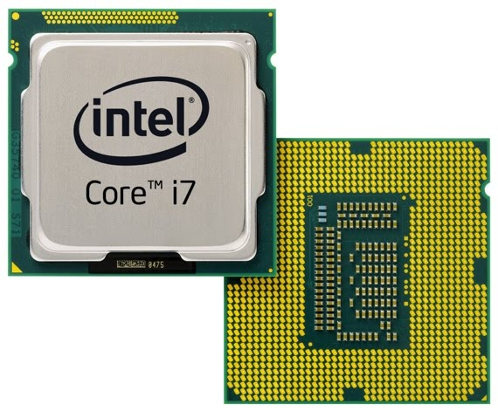
HW Component: CPU
Central Processing Unit (CPU): Manipulates the data and controls the tasks performed by the other components.

Slide 5
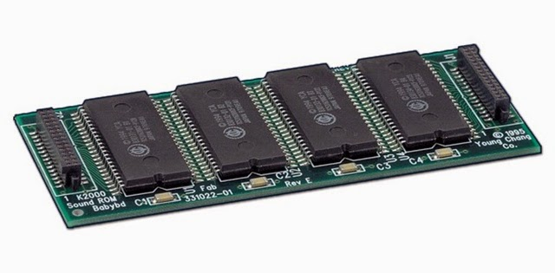
HW Component: Primary Storage
Primary Storage: Temporarily stores data and program instructions during processing.

Slide 6
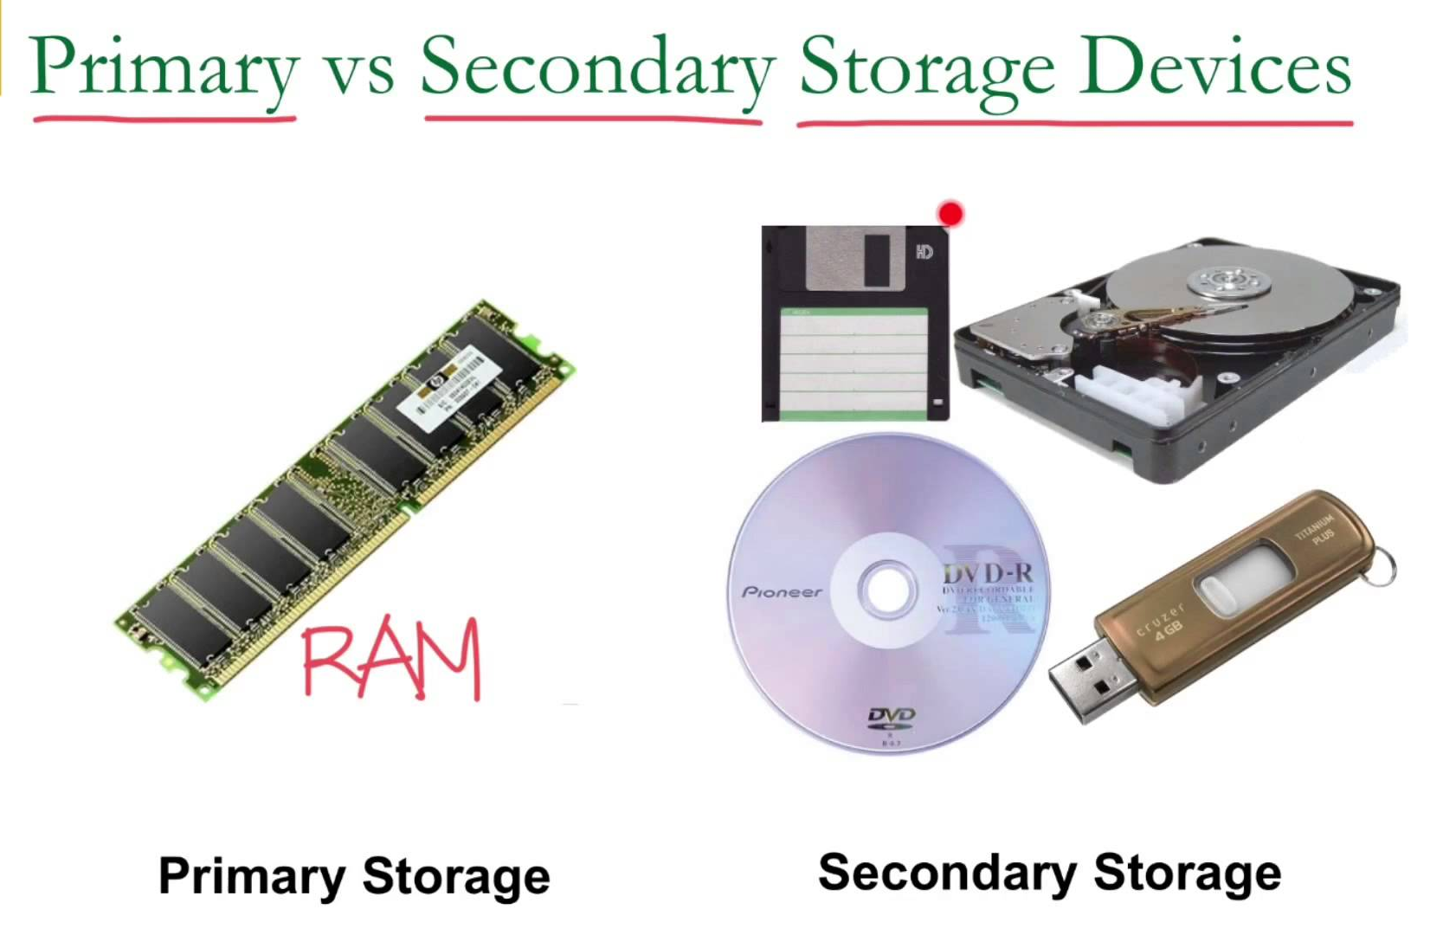
HW Component: Secondary Storage
Secondary Storage: Stores data and programs for future use.

Slide 7
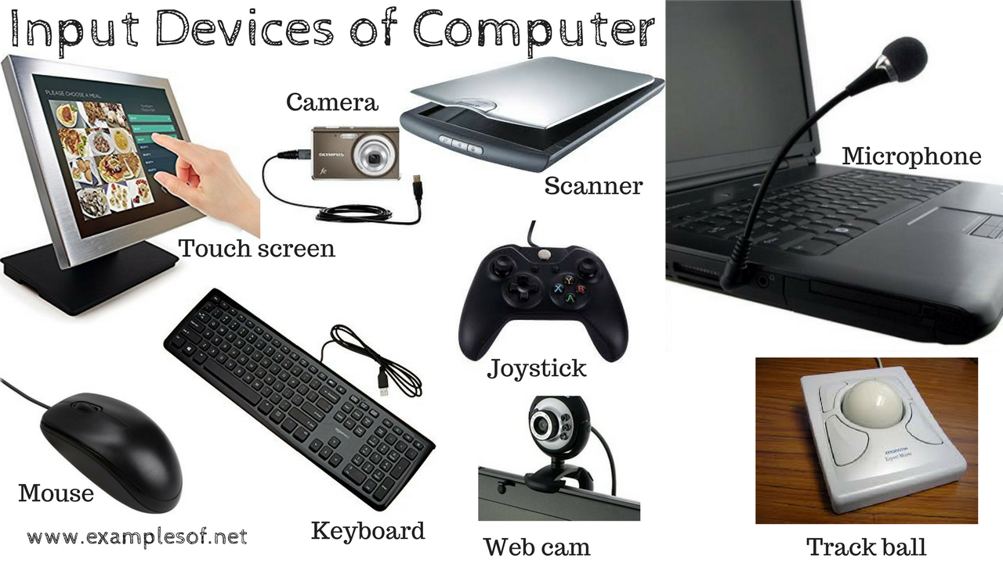
HW Component: Input Technologies
Input Technologies: Accept data and instructions and convert them to a form that the computer can understand.

Slide 8
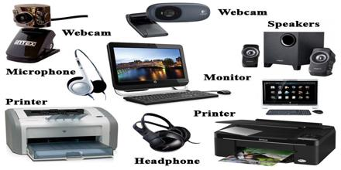
HW Component: Output Technologies
Output Technologies: Present data and information in a form people can understand.

Slide 9
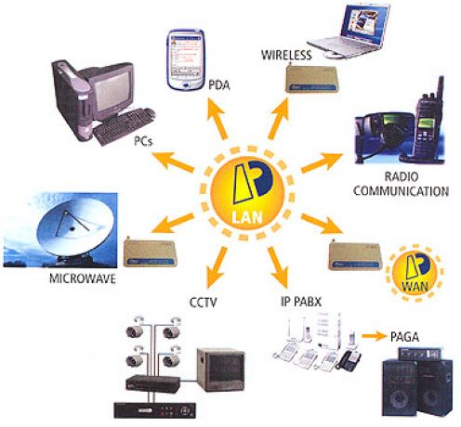

HW Component: Communication Technologies
Communication Technologies: Provide for the flow of data from external computer networks (e.g., the Internet and intranets) to the CPU, and from the CPU to computer networks.

Slide 10
Strategic Hardware Issues
How do organizations keep up with the rapid price reductions and performance advancements in hardware?
How often should an organization upgrade its computers and storage systems?
Will upgrades increase personal and organizational productivity?
How can you measure productivity increases?

Slide 11
Strategic Hardware Issues
Portable computers and advanced communications technologies have enabled employees to work from home or from anywhere.
Will these new work styles benefit employees and the organization?
How do organizations manage such new work styles?

Slide 12
Strategic Hardware Issues
How do organizations manage employees who use their own portable devices (e.g., tablets and smartphones) for both personal and work purposes?
That is, how do organizations handle the bring-your-own-device phenomenon?

Slide 13
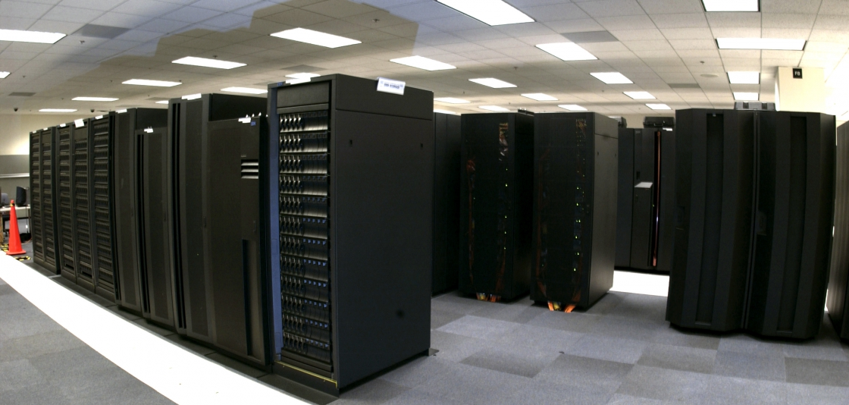
Computer Hierarchy: Speed, Cost, Performance, Storage, Reliability
Supercomputers:
High cost
The fastest computers
Generally used by large organizations
Execute computationally demanding tasks involving very large datasets
Notes:
Execute computationally demanding tasks involving very large datasets (military, scientific research, national weather service, etc.)

Slide 14
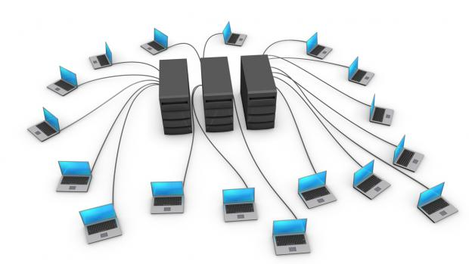
Computer Hierarchy: Speed, Cost, Performance, Storage, Reliability
Mainframe Computers:
High performance
High reliability
Can handle millions of transactions

Slide 15
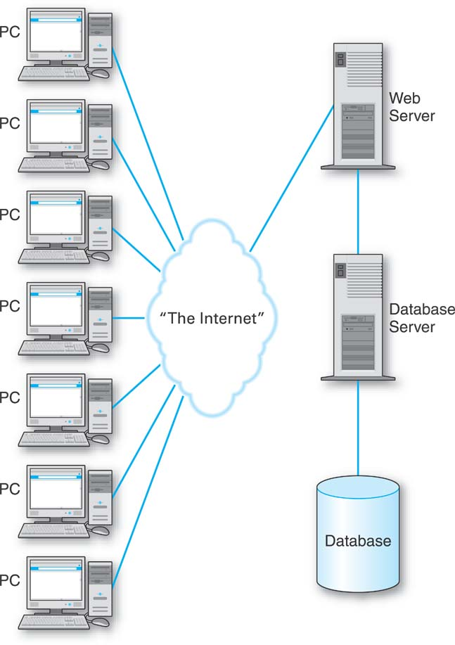
Computer Hierarchy
Client/server system built over Internet:
The client computers are PCs or any computing devices that end users use to connect to the Internet.
The server computers are the online service web servers and database servers.

Slide 16
Computer Hierarchy
Thin vs. fat-client systems depending on complexity and functionalities installed with client/server systems:
Thin client: A client computer designed so that most processing and data storage occur on the server; Less complex.
Fat client: More complex; more powerful functional and processing capacities.

Slide 17
Computer Hierarchy: Speed, Cost, Performance, Storage, Reliability
Microcomputers (PC)
Laptop Computers
Netbook Computers: Optimized for Internet-based services.
Tablet Computers
Wearable Computers

Slide 18
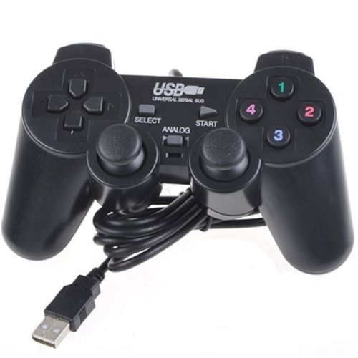
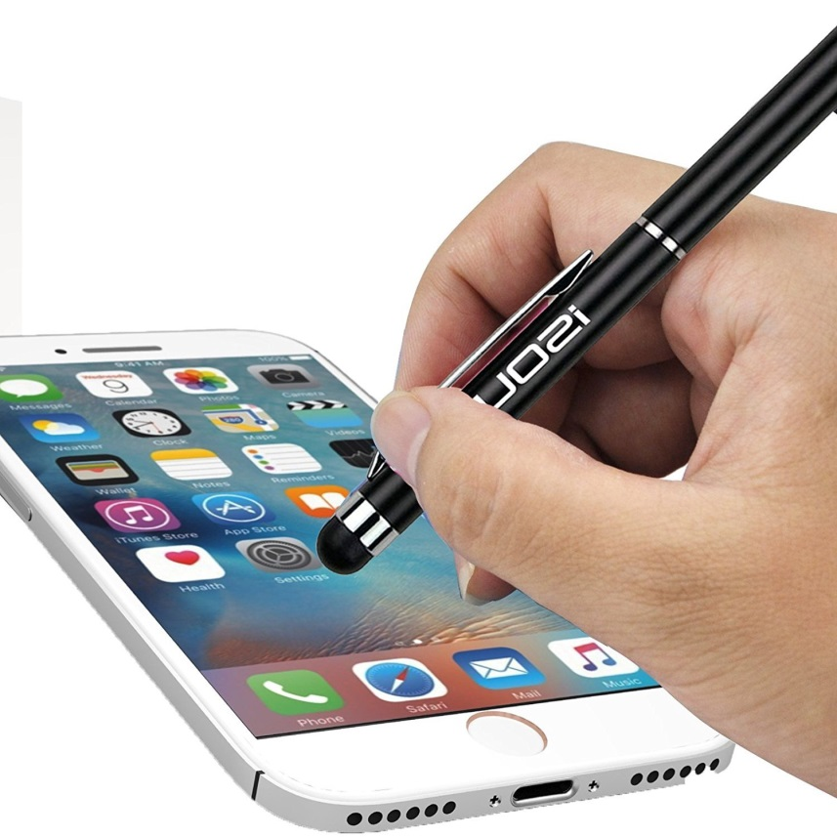
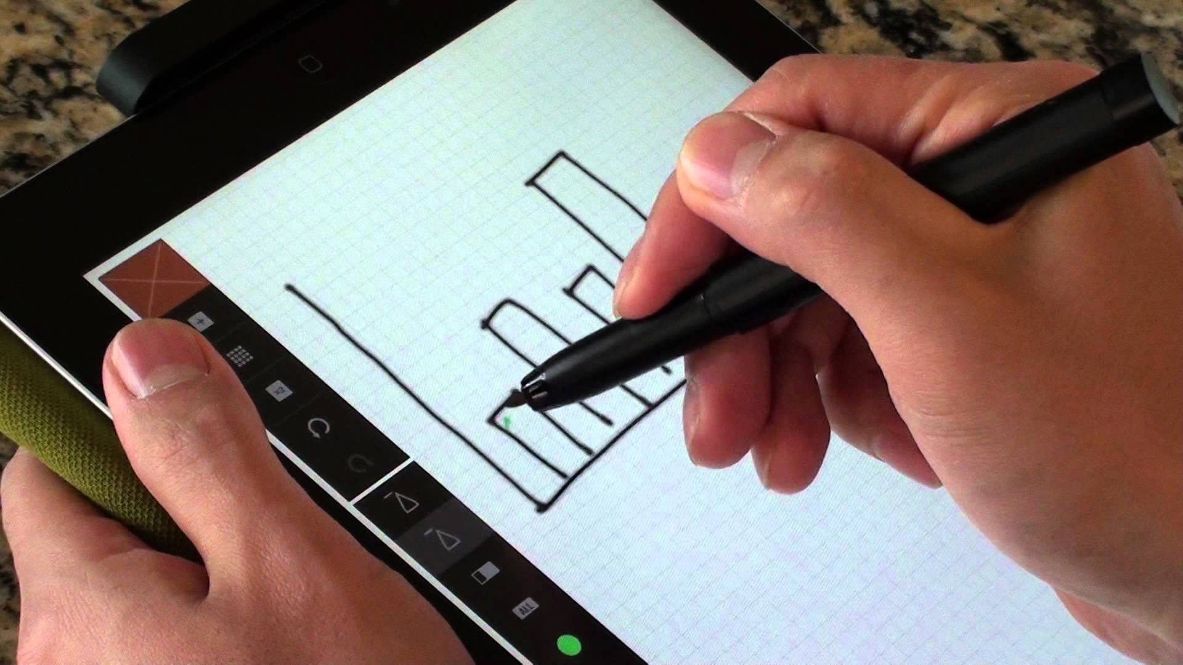
Input Technologies
Joystick
Touchscreen
Stylus
Digital Pen
Web Camera
Voice Recognition

Slide 19
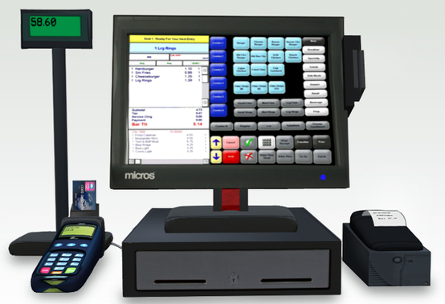
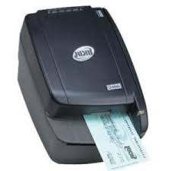
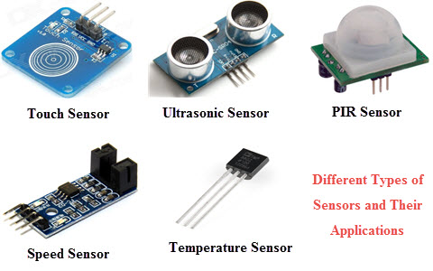
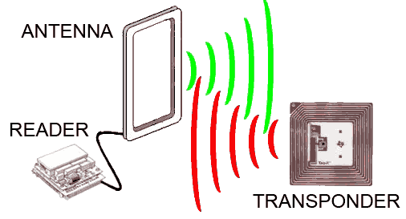
Input Technologies
Wii
Sensors
Barcode scanners
Point-of-sale Terminals
Magnetic Ink Character Reader
Radio-Frequency Identification (RFID)

Slide 20
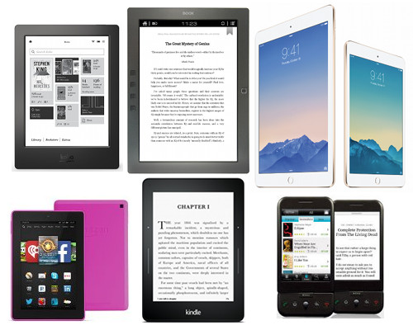
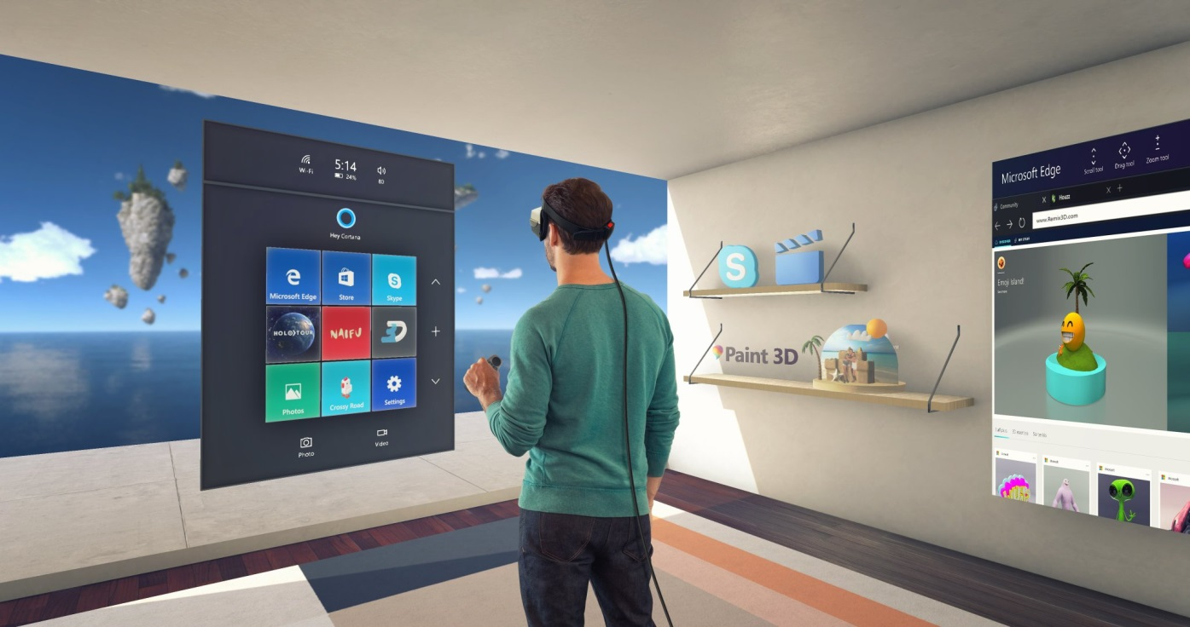
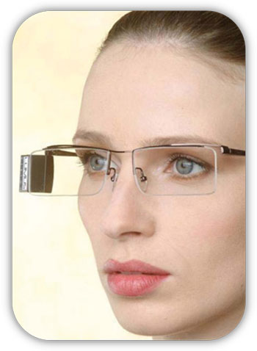
Output Technologies
Printers
Monitors
Voice Output
Liquid Crystal Displays (LCDs)
Retinal Scanning Displays
Electronic Book Reader
Virtual Reality Displays
……
Notes:
A retinal scanning display is a new kind of display that directly uses the retina as a projection screen. This differs from, for example, a TV which first creates an image on a screen outside the eye. Although a retinal scanning display needs no screen, the principle of creating an image is similar to that of a TV. Where the TV uses an electron beam to create (scan) a raster pattern on a screen, a retinal scanning display uses a beam of light to scan a raster pattern on the retina. The way to get from an equally illuminated raster pattern to an image is to modulate the intensity of the beam as it scans. Since the eye does not look at a physical screen, people often wonder what the image of a retinal scanning display will look like. Upon seeing the image, the general response is: 'It looks just like a normal display'. In fact it is a normal display, but one that has many advantages compared to other kind of displays, such as: possibility of high brightness, large color gamut, possibility of high-resolution and good image quality (https://www.ncbi.nlm.nih.gov/pubmed/10445009).

Slide 21
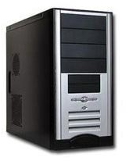
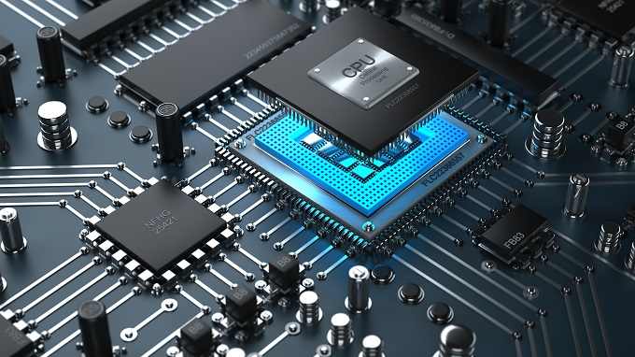
Central Processing Unit
A microprocessor
Embedded in a circuit on a silicon chip: Motherboard
Made up of millions of microscopic transistors
Performs the actual computation inside computer

Slide 22
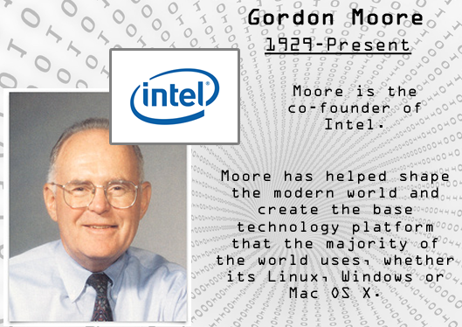
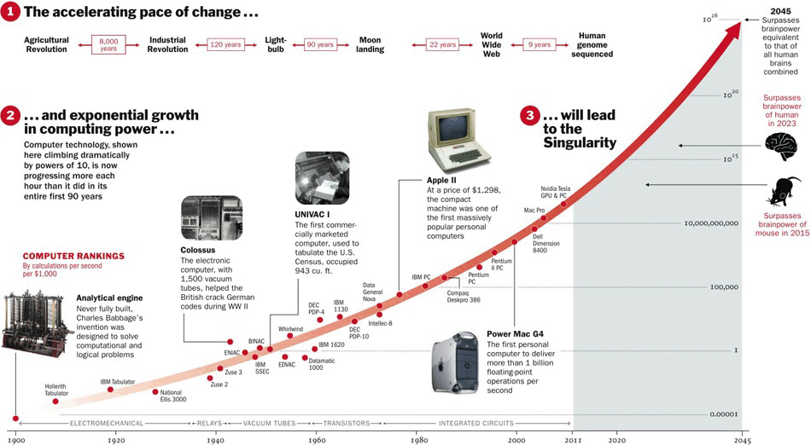
Central Processing Unit
Moore’s Law: In 1965, Gordon Moore, a cofounder of Intel Corp, predicted that microprocessor complexity would double approximately every 18 months.
Advances in Microprocessor Design
Size
Speed
Cost
Notes:
• Producing increasingly miniaturized transistors.
• Placing multiple processors on a single chip. Chips with more than one processor are called multicore chips.
• Intel’s three-dimensional (3D) chips require less power than Intel’s current chips while improving performance.

Slide 23
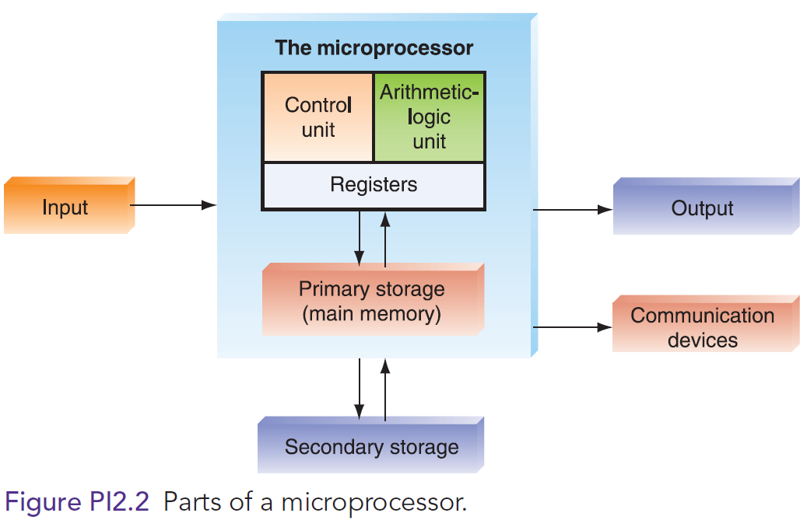
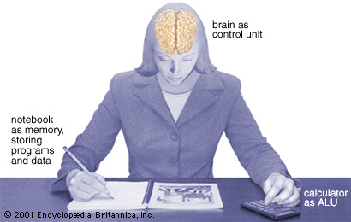
How CPU works??
CPU consists of:
  Control unit (CU)
  Arithmetic logic unit (CLU)
  Main memory
  Registers

Slide 24
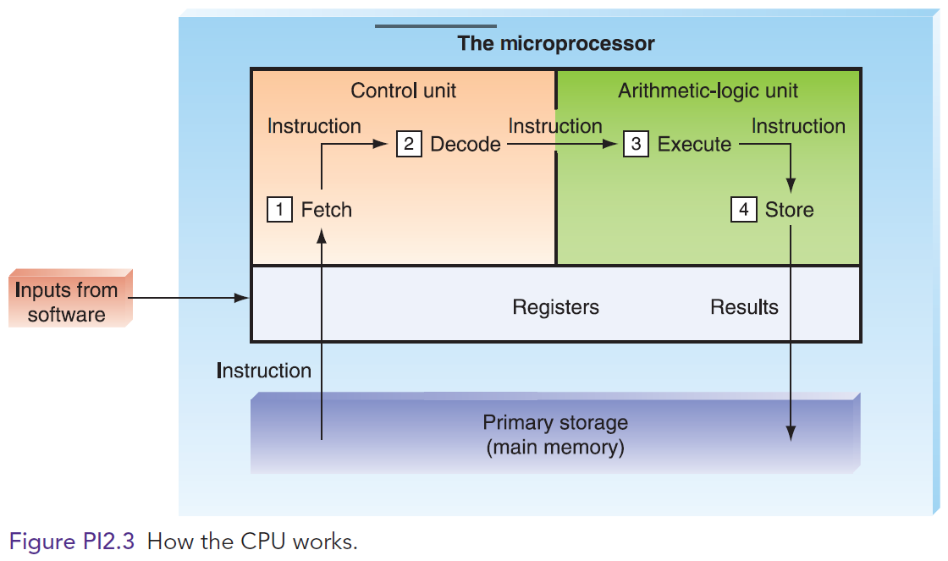
The ALU receives the data and instructions from the registers and makes the desired computation.
The Control Unit directs the flow of data and instructions within the chip.
Inputs from software consisting of data and brief instructions about what to do with the data come into the CPU.
Inputs are stored in registers until they are sent to the next step in the processing.
The data are sent to storage registers and then back to a storage place. The transformed data go to another register and then on to other parts of the computer.
Here is how CPU works??

Slide 25
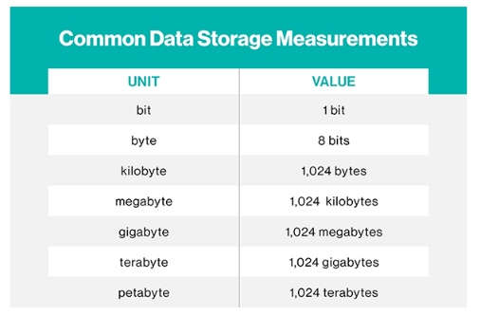
Computer Memory
To put these volumes into perspective using the classic grains of sand analogy:
A megabyte is a tablespoon of sand;
A terabyte is a sandbox two-feet wide and one-inch deep;
A petabyte is a mile-long beach;
An exabyte is a beach extending from Maine to North Carolina.

Slide 26
Computer Memory: Primary Storage
Takes place in chips in the motherboard
Close to CPU for efficient data and instruction processing
Stores 3 types of information:
  Data to be processed by the CPU
  Instructions for the CPU as to how to process the data
  Operating system programs that manage various aspects of the computer’s operation

Slide 27
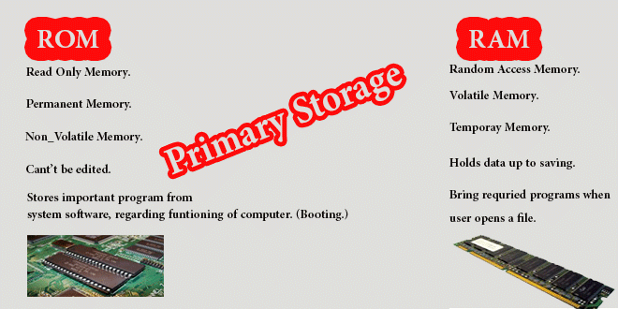
Computer Memory: Primary Storage
4 types of primary storage:
  Registers: part of the CPU; store limited amounts of instructions and data only immediately before and after processing.
  Cache memory: High-speed memory; Store frequently used data; physically close to the CPU.
  Random Access Memory (RAM): Holds a software program and small amounts of data for processing.
  Read-Only Memory (ROM): Nonvolatile storage.
Notes:
Four main types of primary storage:
Registers: part of the CPU. They have the least capacity, storing extremely limited amounts of instructions and data only immediately before and aft er processing.
Cache memory: is a type of high-speed memory that enables the computer to temporarily store blocks of data that are used more often and that a processor can access more rapidly than main memory (RAM). Cache memory is physically located closer to the CPU than RAM.
Random Access Memory (RAM): is the part of primary storage that holds a software program and small amounts of data for processing.
Read-Only Memory (ROM): is the place—actually, a type of chip—where certain critical instructions are safeguarded. ROM is nonvolatile, so it retains these instructions when the power to the computer is turned off.

Slide 28
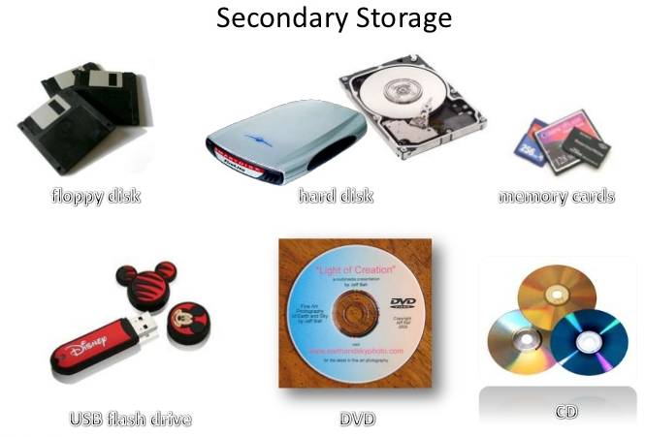
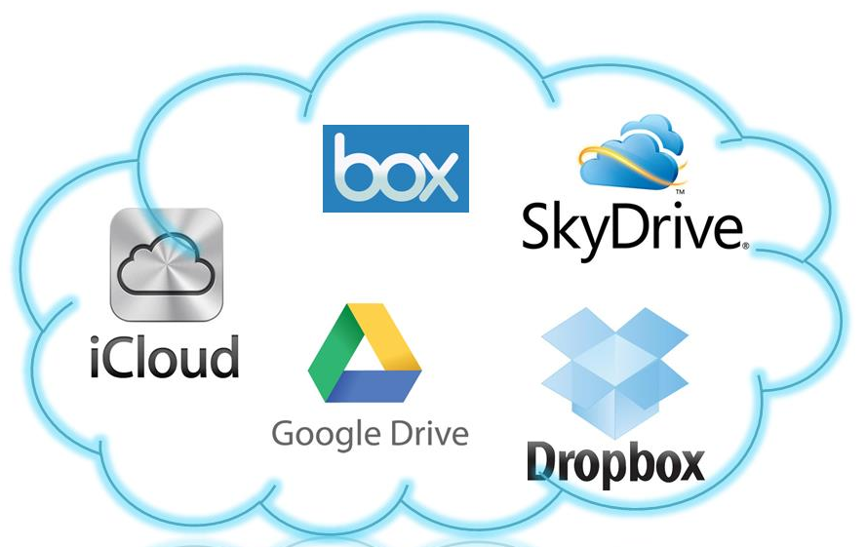

Computer Memory: Secondary Storage
Nonvolatile.
Takes more time to retrieve data from it than from RAM.
Cheaper than primary storage
Can utilize a variety of media
Notes:
Secondary Storage: Stores very large amounts of data for extended periods.
Types of Secondary Storage:
Magnetic Tape: is kept on a large open reel or in a smaller cartridge or cassette. It is the cheapest storage medium, and it can handle enormous amounts of data. It is also the slowest method for retrieving data because all the data are placed on the tape sequentially.
Solid-State Drives (SSDs): are data storage devices that serve the same purpose as a hard drive and store data in memory chips. Whereas hard drives have moving parts, SSDs do not.
Optical Disks: can store a great deal of information, both on a routine basis and when combined into storage systems. Types of optical disks include compact disk (CD) read-only memory, digital video disk (DVD)(17GB), and dual-layer Blu-ray disks (50 GB).
Flash Memory Devices (or memory cards): nonvolatile electronic storage devices that contain no moving parts and use 30 times less battery power than hard drives. Flash devices are also smaller and more durable than hard drives. One popular flash memory device is the thumb drive (also called memory stick, jump drive, or flash drive).
------------------------------

Slide 29
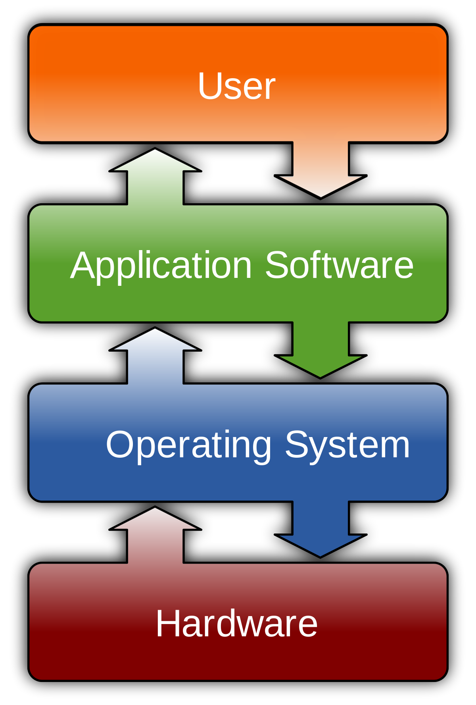
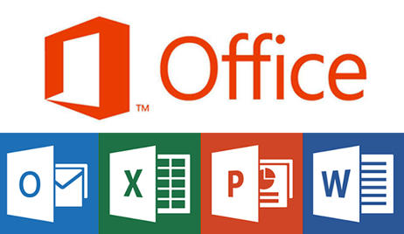
Software
Computer programs or the instructions given to hardware and other software.
Programming: The process of program coding.
Programmers: IT professionals on programing.
2 Types of Software:
  Systems Software.
  Application Software.
Notes:
2 Types of Software:
Systems Software: Programs that control and support the computer system and its information-processing activities..
Application Software: Consists of instructions that direct a computer system to perform specific information-processing activities and also to provide functionality for users.
Operating System (OS): the “director” of your computer system’s operations. It supervises the overall operation of the computer by monitoring the computer’s status, scheduling operations, and managing input and output processes. It also provides an interface between the user and the hardware.

Slide 30
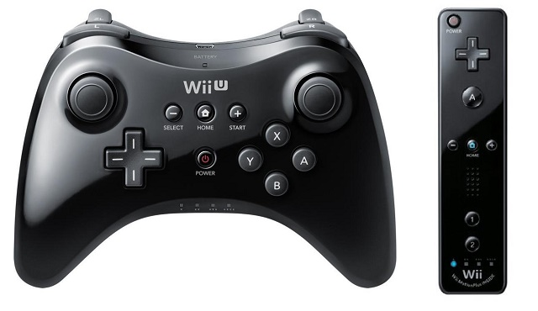
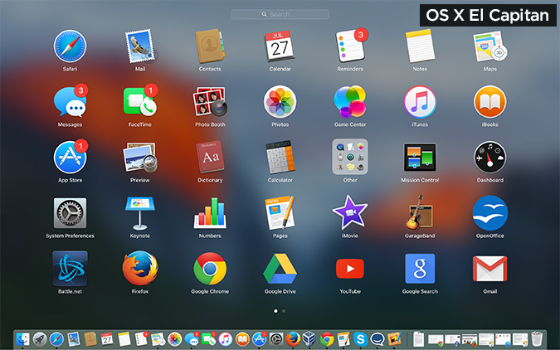
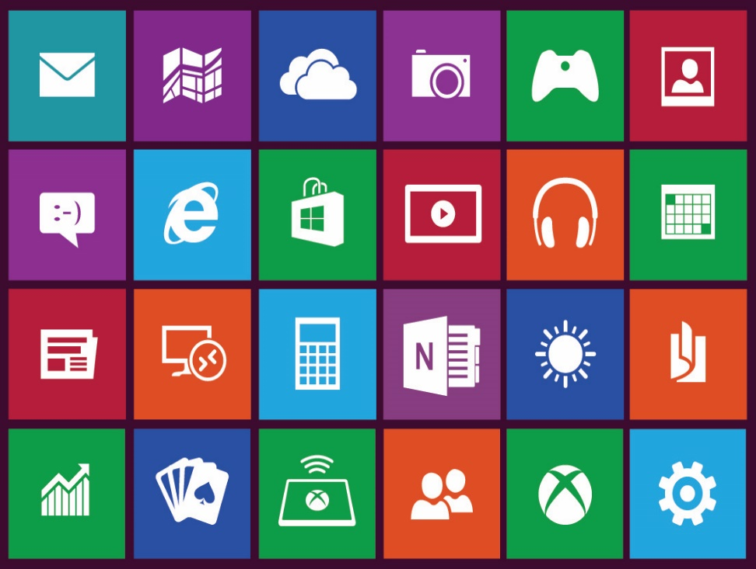
Systems Software
Human-Computer Interface:
Graphical User Interface (GUI)
Social Interface
Motion Control Gaming Consoles
Notes:
Human-Computer Interface:
Graphical User Interface (GUI)
Social Interface: guides the user through computer applications by using cartoon-like characters, graphics, animation, and voice commands.
Motion Control Gaming Consoles (e.g., the Xbox 360 Kinect, the PS3 PlayStation Move, and the Nintendo Wii)

Slide 31
Some Software Issues
Software Defects: Inefficient, poorly designed, and with errors
Good Software: “Usable, reliable, defect free, cost effective, and maintainable.” (SEI)
Software Licensing: Costly; Piracy issues
Open Systems: Free vs. Compatibility
Proprietary Software: Commercial.
Open-Source Software: No cost; Distributed with license terms to ensure source code available.

Slide 32
Summary
Introduction to Hardware (HW).
Introduction to Software (SW).
Differentiate between the two SW types.
Discuss strategic issues that link HW & SW design to business strategy.
Explain how can be HW & SW can be integrated into the business processes and strategies.

